Slide 1
A Dwindling Role for Coal:
Tracking the Electricity Sector Transition and What It Means for the Nation
Notes:
Report Landing Page: www.ucsusa.org/coaltransition

Slide 2
Approach
Look back: Compared coal fleet operational in 2008 with coal fleet operational in 2016, flagging retirements and natural-gas conversions.
Look forward: Compared coal fleet in 2016 with possible future fleet, based on an economic vulnerability assessment and announced retirements.
Proximity analysis: Considered these transitions through the overlay of a proximity analysis (NOT an EJ analysis) looking at the percent of low-income and minority residents within a 3-mile radius of each unit.
Notes:
Methodology in Brief:
Part 1: We constructed a list of all coal units operating in 2008, and identified which ones had retired or converted to other fuels by 2016.
Part 2: We conducted an economic stress test on the remaining operating coal units in 2016. This is a spreadsheet analysis, not a full-on modeling projection of what will happen to the electricity sector.
Part 3: We performed a demographic screening of the communities living nearby all the coal plants we identified. While this is not an environmental justice analysis, the results can be used by communities to plan for transition. Data available at http://www.ucsusa.org/sites/default/files/attach/2017/09/dwindling-role-coal-data.xlsx .

Slide 3
Key Finding: The transition away from coal has fundamentally shifted our nation’s electricity system, and the trend continues, with vulnerable coal plants especially in the Southeast.

Slide 4
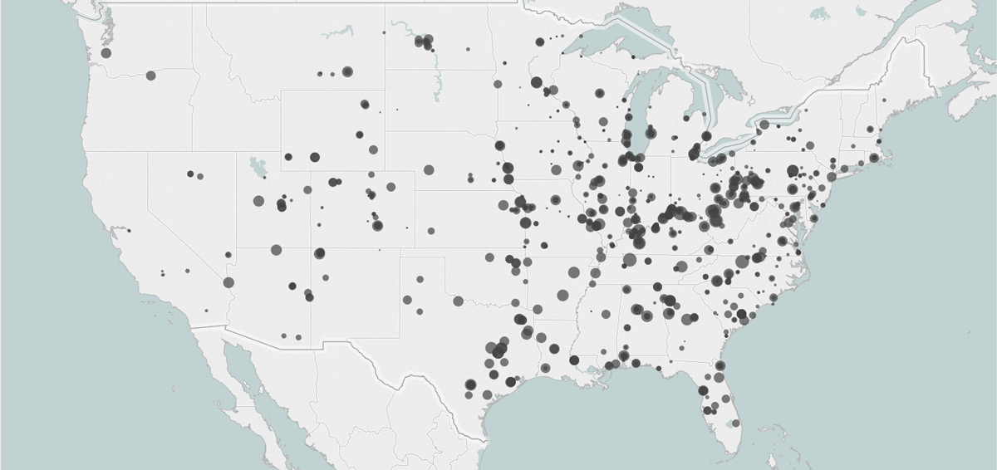
Coal Generating Units in 2008
This analysis identified 1,256 coal-fired generating units operating in 2008. These units represented 356.7 GW of generating capacity.
Notes:
We identified 1,256 coal generating units operating in 2008. These units represented 356.7 GW of generating capacity.

Slide 5
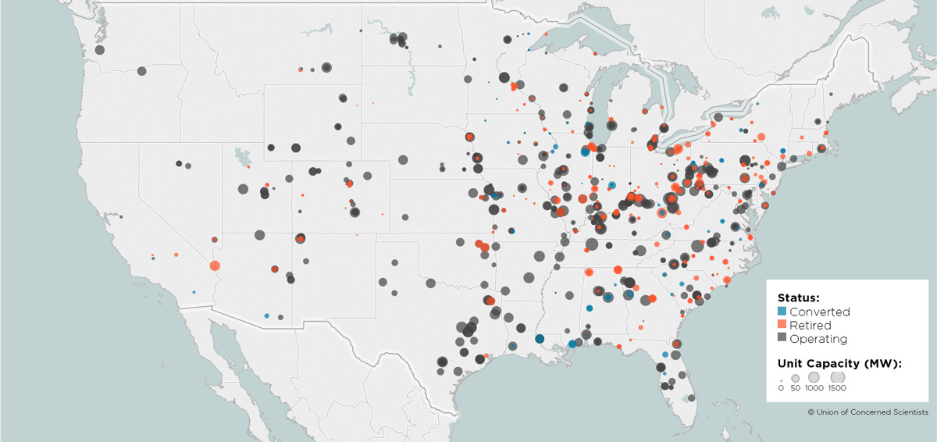
Coal Generating Units in 2016
By the end of 2016, 452 units (59.3 GW) had retired, and 98 units (13.4 GW) had converted to another fuel, mostly natural gas, leaving 284.1 GW of coal capacity.
Notes:
By the end of 2016, 452 units (59.3 GW) had retired, and 98 units (13.4 GW) had converted to another fuel, mostly natural gas, leaving 284.1 GW of coal capacity.

Slide 6
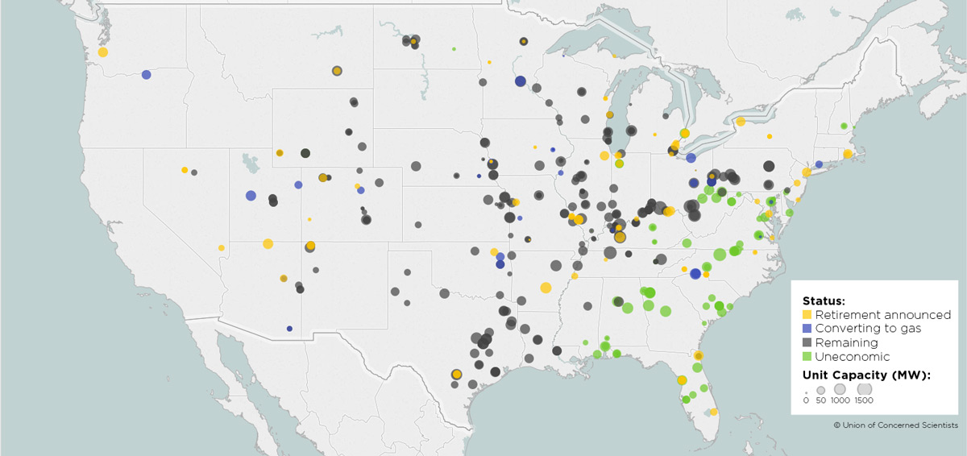
Looking Ahead…
We identified 128 units (38.1 GW) that are already slated for retirement, in addition to 35 units (12.8 GW) that are slated for retirement or conversion to another fuel. In total, those units represent 51 GW of coal generating capacity, or 18% of the capacity remaining in 2016.
Notes:
Looking out into the future, we identified 128 units (38.1 GW) that are already slated for retirement, in addition to 35 units (12.8 GW) that are slated for either retirement or conversion to another fuel (again, mostly natural gas). That represents 51 GW of coal generating capacity, or 18% of the capacity remaining in 2016.
The green dots show the units that failed our economic stress test (which we’ll get to in a moment) indicating that these units are currently more expensive to run than an equivalent existing natural gas plant. (Note that 84 units, or 4.2 GW, were excluded from the stress test and are not shown here.)

Slide 7
Key Finding: 38 percent of operating coal capacity is facing or may face retirement, including 51 GW already announced for retirement or possible conversion, and 57 GW that we identified as uneconomic compared to existing natural gas.

Slide 8
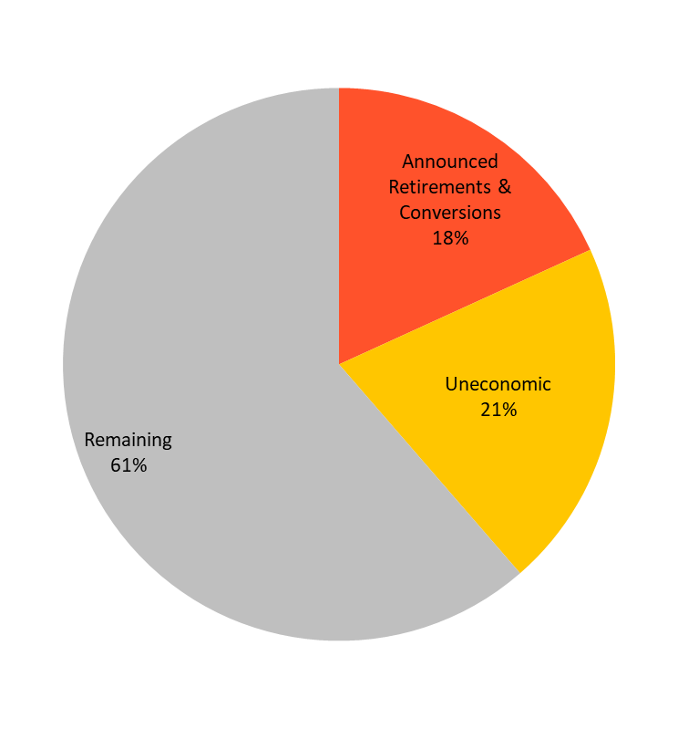
Economic Stress Test Results
Percentages represent portion of total coal capacity, excluding units with insufficient data. Uneconomic units are relative to equivalent existing NGCC.
Notes:
Our economic stress test is a spreadsheet analysis of the remaining coal fleet that was operational at the end of 2016. We calculated the O&M costs for running each unit and compared to cleaner alternatives. (Important to note that this was not a model of the electricity system in terms of dispatch, etc.)
This shows the result comparing the cost of running each coal unit to an equivalent NGCC unit (meaning assumed to operate at the same capacity factor). Same comparison as shown in the forward-looking map earlier. It’s also worth noting that we did not consider the cost of adding any missing pollution control equipment.

Slide 9
Key Finding: Many more coal units are on the verge of being uneconomic. With a conservative $10/ton CO2 price, almost 92 GW of coal is uneconomic relative to existing natural gas.

Slide 10
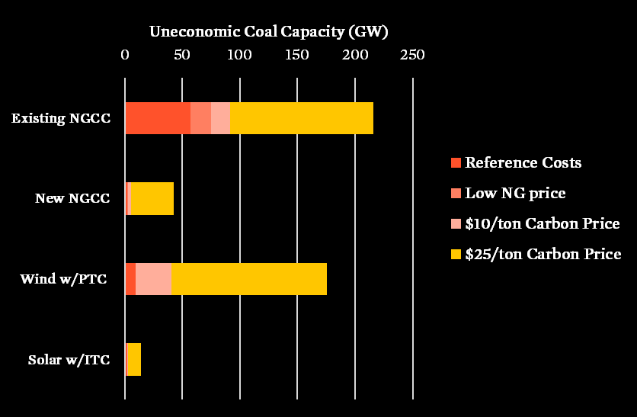
Sensitivity Analysis
Notes:
We compared each coal unit to four different cleaner alternatives (existing and new NGCC and wind and solar with tax credits). We also did a few different sensitivities to show how our results might change given different assumptions—and a few of them are shown here. We considered a carbon price adder as a proxy for additional requirements on coal that may come down the line. Note how much more capacity is uneconomic even with a small carbon price.
See our technical appendix for more detail: http://www.ucsusa.org/sites/default/files/attach/2017/09/A-Dwindling-Role-for-Coal-technical-appendix.pdf

Slide 11
Key Finding: Four community snapshots highlight different aspects of how the transition away from coal
Notes:
Interactive Map:
http://www.ucsusa.org/clean-energy/coal-and-other-fossil-fuels/coal-communities#.WgniCIhOkps

Slide 12
Lansing, MI
How A Coal Plant in Michigan Became an Insurance HQ
“The site itself was not paying any property taxes before the redevelopment. It won’t generate taxes for a while because of the tax abatements, but a few more years down the road it will. There’s also a significant positive economic impact of having those 1,100 employees downtown.”
- Karl Dorshimer, director of business development with Lansing Economic Area Partnership (LEAP)
Notes:
http://blog.ucsusa.org/jeremy-richardson/lansing-coal-plant-closure

Slide 13
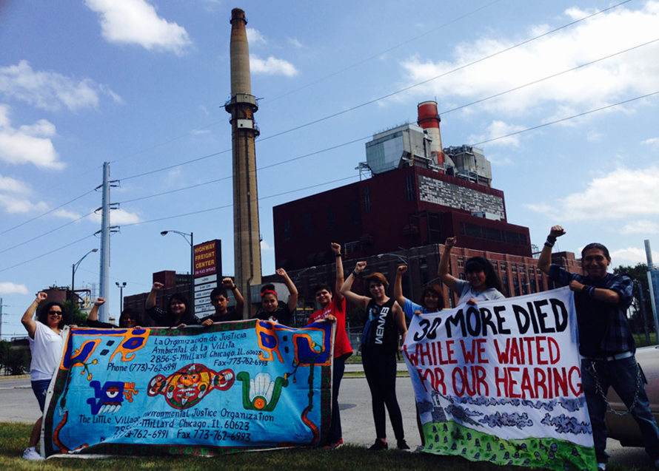
LANSING, MI
Chicago, IL The Struggle for a Just Transition of the Crawford Coal Plant in Little Village Continues
“Across the Midwest environmental justice communities are leading the fight to close coal plants, incinerators, and other polluting factories. Community-led redevelopment of the Crawford plant would not only profoundly benefit Little Village, but also stand as a powerful symbol of environmental justice.”
- Dr. Antonio Lopez, senior advisor at Little Village Environmental Justice Organization
Notes:
http://blog.ucsusa.org/guest-commentary/chicago-coal-plant-closure
Antonio’s colleague Kim Wasserman was featured on the Got Science? podcast

Slide 14
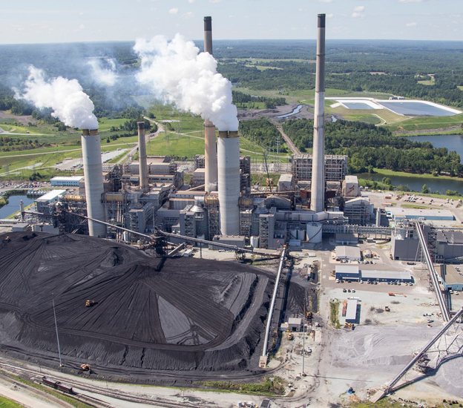
Semora, NC
This Is What It’s Like to Live Near a Coal Plant in North Carolina
“Duke is claiming that there were no medical problems [because of the coal ash], even though their own statistics and reports show there is a risk of health issues. They are asking people to sign paperwork saying that they will not sue for medical problems … No one is taking that deal. If Duke believes their ash hasn’t affected our health, then they shouldn’t need a release of medical claims.”
- Linda Jamison, community activist
Notes:
http://blog.ucsusa.org/jeremy-richardson/roxboro-coal-plant

Slide 15
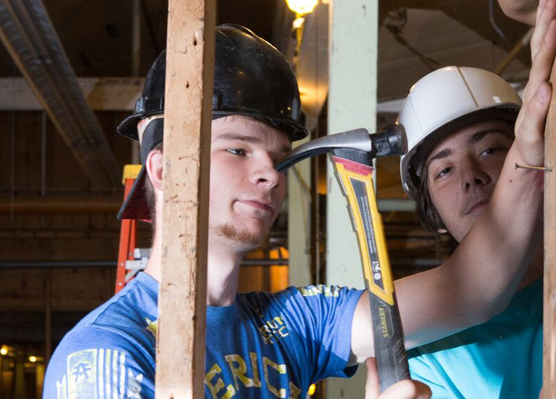
Huntington, WV New Economic Opportunities in the Heart of Coal Country
“We employ former strip miners who now reclaim and rejuvenate the soil through our agriculture work on former mountaintop-removal sites. At Coalfield Development, we support a family of social enterprises that work in community-based real-estate, green-collar construction, mine-land reclamation, artisan trades, sustainable agriculture, and solar installation.”
- Brandon Dennison, founder and CEO of Coalfield Development Corporation
Notes:
http://blog.ucsusa.org/guest-commentary/west-virginia-coal-plant
Brandon was featured on the Got Science? podcast

Slide 16
Implications & Recommendations
Stakeholder engagement is critical—especially with coal-dependent communities, utility workers, coal miners, and minority and low-income residents living near coal plants
Federal response is needed—in the form of transition assistance and worker training for displaced workers
Avoid overreliance on natural gas
Support clean energy development

Slide 17
www.ucsusa.org/coaltransition
Thank You

